Slide 1
CHINA: THE MYTHICAL PAST

Slide 2
MYTH
A Matter of faith, not science. Myths are no less powerful than more quantifiable methods of recording the past.
Creation myths fall into 5 general classifications
From chaos or nothingness.
From a cosmic egg or primordial mound.
From parents who are separated.
From a process of earth splitting.
Following the emergence from other worlds.
Note: cited in The Book of Gods, Goddesses, Heroes and Other Characters of Mythology by PJ Criss, grandpa@raven.cybercomm.net

Slide 3
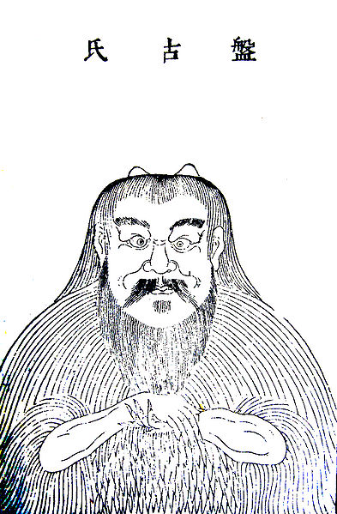
PAN GU (盤古)
Roughly translated "coiled antiquity," the original creature, born of a cosmic egg.
Separated heaven and earth (the cosmos), resembling an enormous stone, in half
When he died, his eyes became the sun and moon, his blood, the rivers and oceans, his muscles, the mountains, his hair the grasses and trees
Humans and animals derived from his body lice!

Slide 4
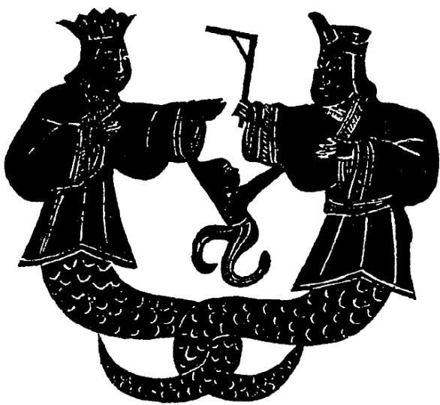
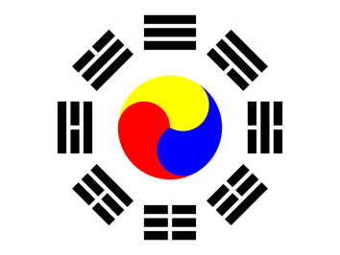
FU XI (伏羲) AND NU WA (女媧)
Semi-human “Adam and Eve” figures of China’s legendary past.
both figures were serpentine from the waist down.
Fu Xi: inventor of animal husbandry, marriage, the calendar, musical instruments, as well as the trigrams of the Yijing 易經 (Book of Changes).

Slide 5
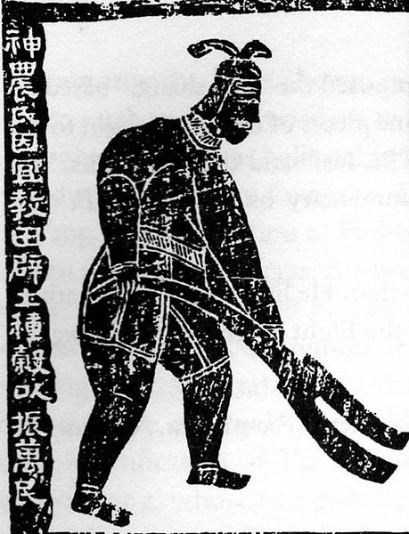
SHEN NONG (神農):
“The divine farmer,” taught men agriculture, set up markets and began commerce.
Shen Nong is also the saint of Chinese medicine. Displayed in fields and drugstores today.
Agrarian images and metaphors have remained important throughout Chinese history.

Slide 6
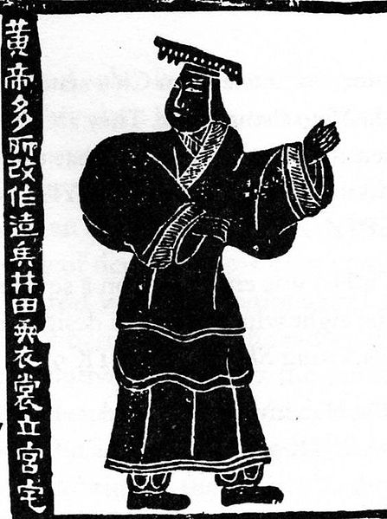
HUANGDI (黃帝) OR “YELLOW EMPEROR”:
Legendary common ancestor of the Han Chinese people.
“Invented” government.
First of five emperors; the last two are the well-known sage (wise) rulers, Yao and Shun.

Slide 7
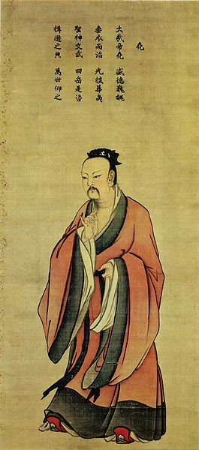
YAO (堯)(ALLEGEDLY 2357-2255 BCE) & SHUN (舜) (ALLEGEDLY 2255-2205 BCE)
Two “Sage Kings” of the legendary Chinese past.
Yao was morally perfect; brought his state, through the nine branches of his lineage together, through his virtue.
Yao selected Shun as his successor rather than his own son, because of Shun's filial piety (Shun was obedient to his stepmother and blind father and his half-brother Xiang, both of whom treated Shun badly
Emperor Yao as imagined by the Song Dynasty painter Ma Lin (馬麟) - WikiCommons

Slide 8
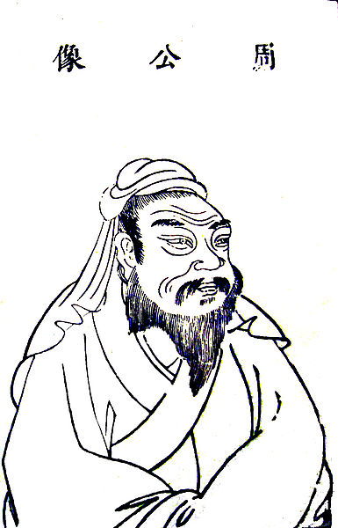
DUKE OF ZHOU (周公)
Regent serving the son of young King Wu, founder of the Zhou dynasty, assisted in founding the new dynasty and writing up the institutions once to rule the people.
Duke of Zhou was the hero of Confucius (551-479 BCE). Confucius was frustrated that the duke never appeared in his dreams.
Duke of Zhou later depicted as the model statesman and scholar, the last man in China to fully realize all of his ideals in his everyday behavior.

Slide 9
Questions?

